Slide 1
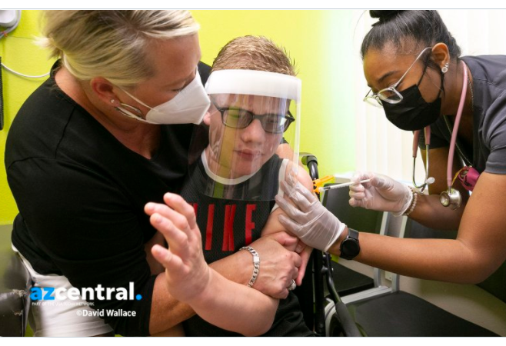
Vaccinating Patients with
Sensory Disorders:
Avoid interruptions.
Communicate with the child at a level that he/she can understand. Use a “tell, show, do” approach when explaining procedures. Be clear and concise.
If possible have them use an electronic device.
Ask the child to put their hands on their stomach (tummy, belly). Ask the parent to “hold hands” with their child to help prevent flinching. Or ask if the child can be placed on the parent’s lap for a “bear hug”:
Child faces parent - arms held under parent’s arms. Parents legs wrap around child’s legs.
Child faces away from parent - sits on parent’s lap facing out. Parent secures arms with each hand and wraps legs around child’s legs.
Start slowly, using only fingers at first to touch the arm. If this is successful, begin using swab/pinching-up of muscle.
Keep the needle out of sight but let them know a “little pinch” as you insert the needle. Needle should be plunged rapidly through the skin without aspiration.
Consider non-pharmaceutical interventions: Ethyl Chloride Spray, Buzzy, Cold compress
Observe unusual body movements and anticipate future movements. Keep area around the child clear.
Immobilization techniques may be used only with parental consent to keep the child from potential injury.
Reward cooperative behavior with reinforcements that are motivating to the child - music, stickers, verbal reinforcement, etc.
“Bear Hugs”
Therapeutic Holds & tips for vaccinating Older Children
https://twitter.com/DavidWallce/status/1392981542952071169
① Facing Parent
② Facing Away from Parent

